Slide 1
Module: 2 Circuit and Packet Switching Switched Communication Networks – Circuit Switching – Packet Switching – Comparison – Implementing Network Software, Networking Parameters ( Transmission Impairments, Data Rate and Performance)

Slide 2
NEED FOR SWITCHING
Whenever we have many devices, the interconnection between them becomes more difficult as the number of devices increases. Some of the conventional ways of interconnecting devices are:
Point-to-point connection between devices as in a mesh topology
Connection between a central device and every other device – as in star topology.
Bus topology – not practical if the devices are at great distances
All these techniques require extensive cabling, dependence on a central server or a central bus.
The better solution to this interconnectivity problem is switching.

Slide 3
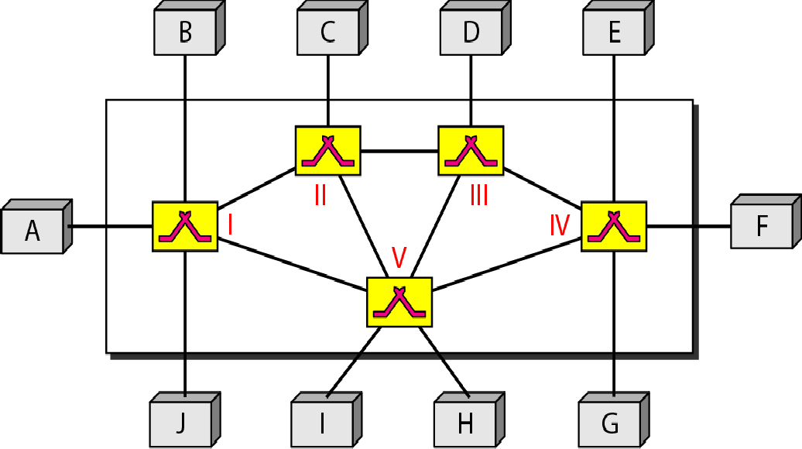
Figure 8.1 Switched network

Slide 4
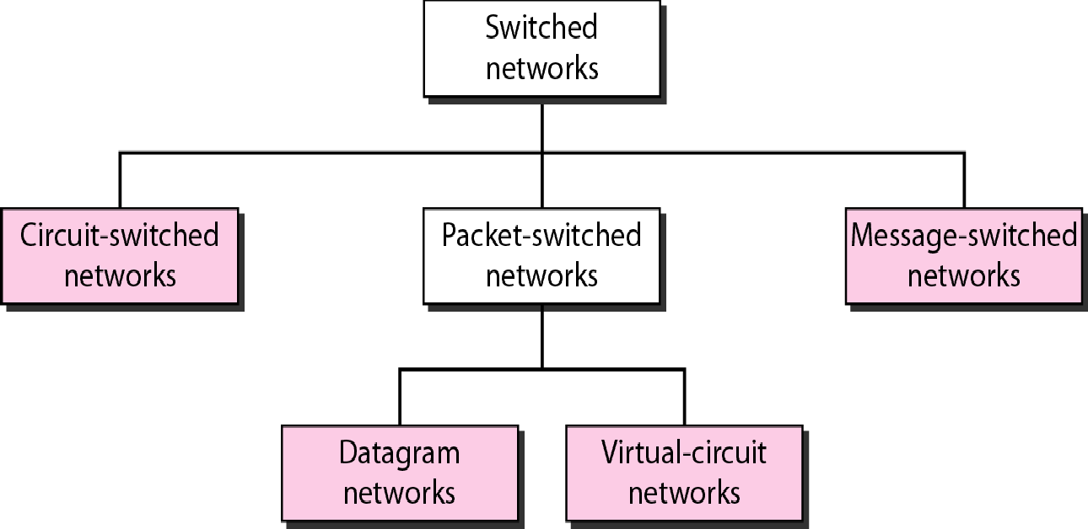
Figure 8.2 Taxonomy of switched networks

Slide 5
8-1 CIRCUIT-SWITCHED NETWORKS
A circuit-switched network consists of a set of switches connected by physical links.
A connection between two stations is a dedicated path made of one or more links..
However, each connection uses only one dedicated channel on each link..
Each link is normally divided into n channels by using FDM or TDM.

Slide 6

Note
A circuit-switched network is made of a set of switches connected by physical links, in which each link is
divided into n channels.

Slide 7
PHASES IN CIRCUIT-SWITCHING NETWORKS
The actual communication in circuit- switching requires
3 phases:
connection setup or circuit establishment,
data transfer, and
connection teardown or circuit disconnect.

Slide 8
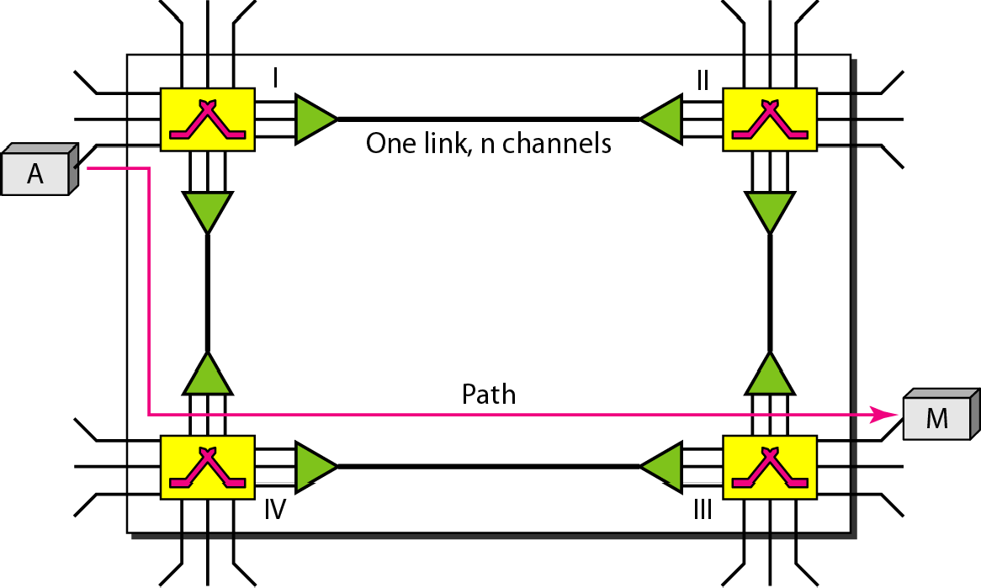
Figure 8.3 A trivial circuit-switched network

Slide 9
Before the two systems can communicate, a dedicated circuit (i.e. a combination of channels and links) must be established.
For example, in fig, when system A needs to communicate to system M, it sends a setup request to switch I. This request contains the address of system M.
Switch I finds a channel between itself and switch IV.
Switch I then sends the request to switch IV. Switch IV finds a dedicated channel between itself and switch III.
Switch III informs system M that system A wants to communicate.
System M then sends an acknowledgement in the opposite direction to system A. Once A receives the acknowledgment, the connection is established.

Slide 10

Note
In circuit switching, the resources need to be reserved during the setup phase; the resources remain dedicated for the entire duration of data transfer until the teardown phase.

Slide 11
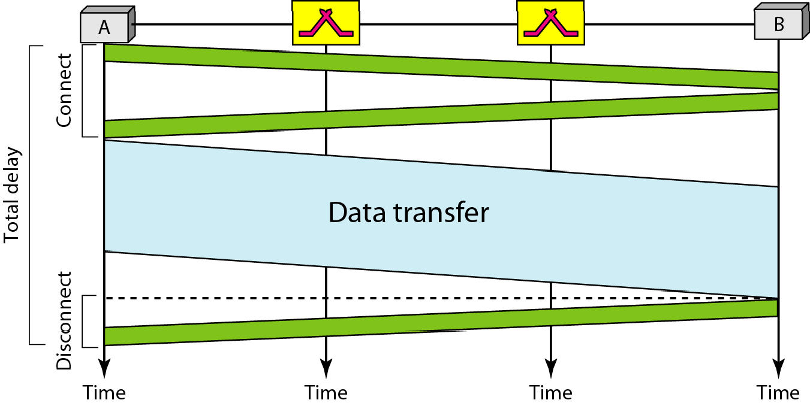
Figure 8.6 Delay in a circuit-switched network

Slide 12

Note
Switching at the physical layer in the traditional telephone network uses the circuit-switching approach.

Slide 13
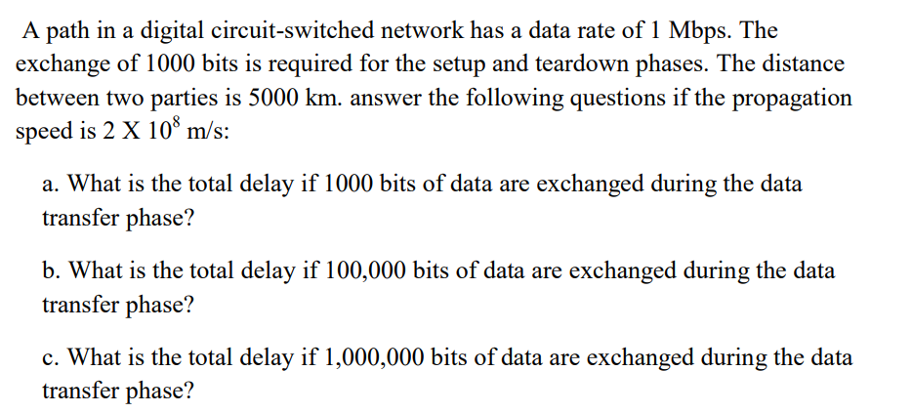

Slide 14
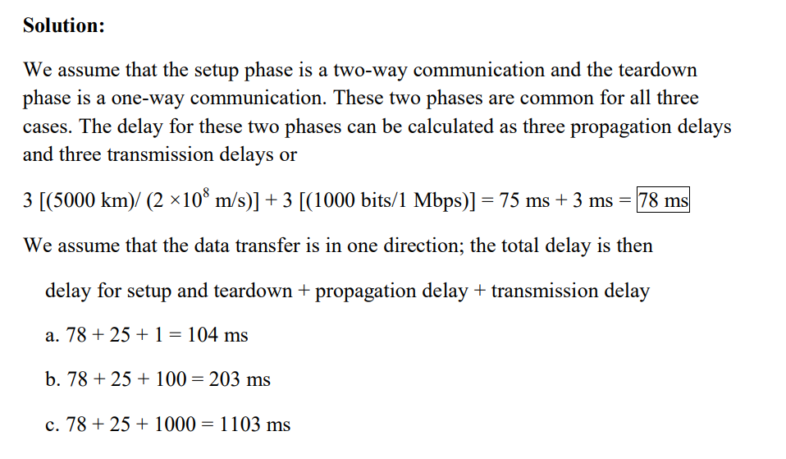

Slide 15
8-2 DATAGRAM NETWORKS
In data communications, we need to send messages from one end system to another. If the message is going to pass through a packet-switched network, it needs to be divided into packets of fixed or variable size.. The size of the packet is determined by the network and the governing protocol.
Topics discussed in this section:
Routing Table Efficiency Delay
Datagram Networks in the Internet

Slide 16
Note
In a packet-switched network, there is no resource reservation; resources are allocated on demand.

Slide 17
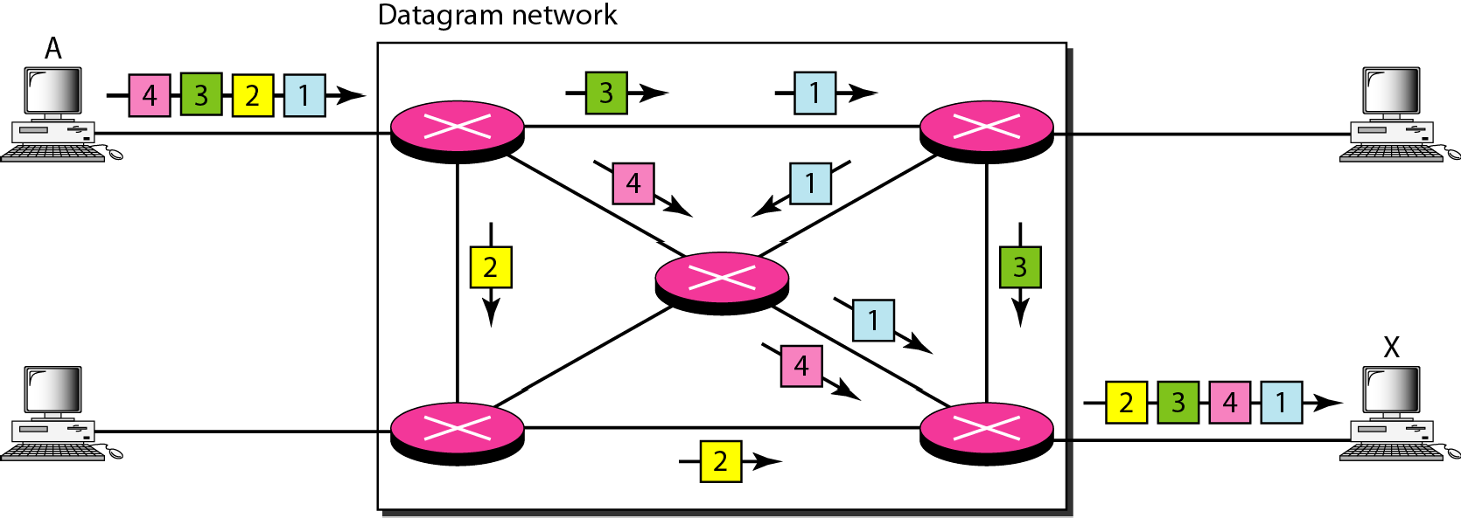
Figure 8.7 A datagram network with four switches (routers)

Slide 18
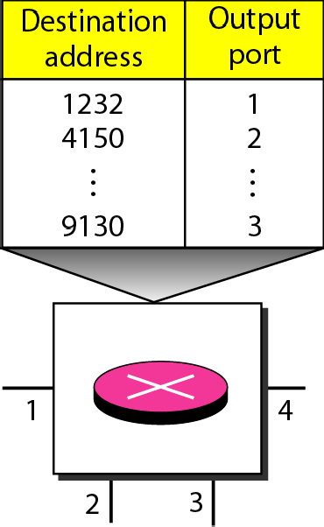
Figure 8.8 Routing table in a datagram network

Slide 19
Note
A switch in a datagram network uses a routing table that is based on the destination address.

Slide 20
Note
The destination address in the header of a packet in a datagram network
remains the same during the entire journey of the packet.

Slide 21
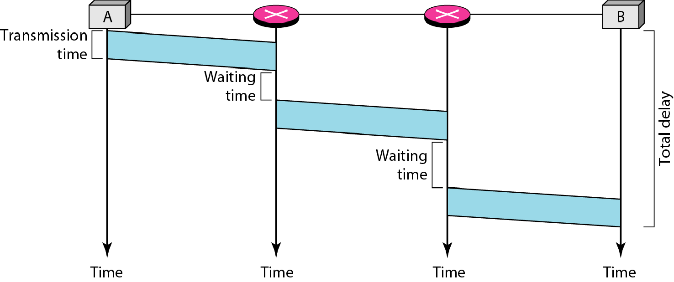
Figure 8.9 Delay in a datagram network

Slide 22
Note
Switching in the Internet is done by using the datagram approach
to packet switching at the network layer.

Slide 23
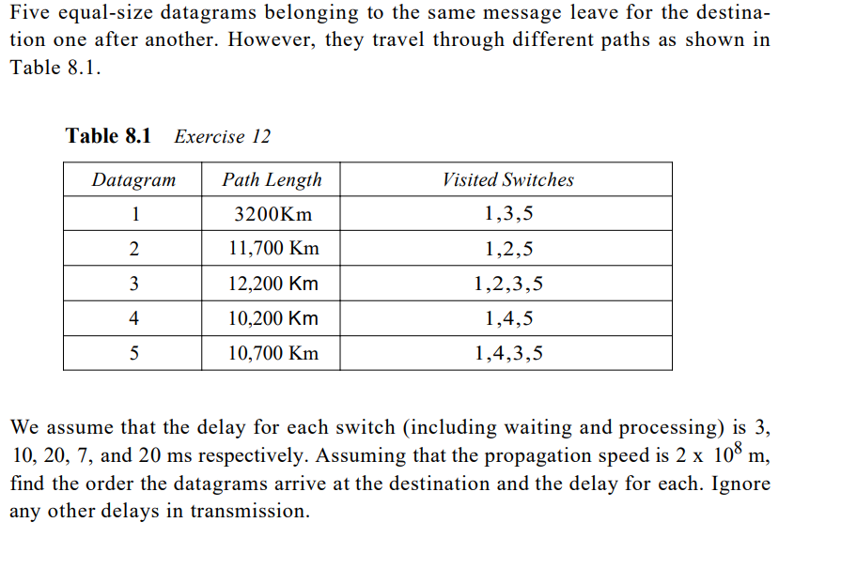

Slide 24
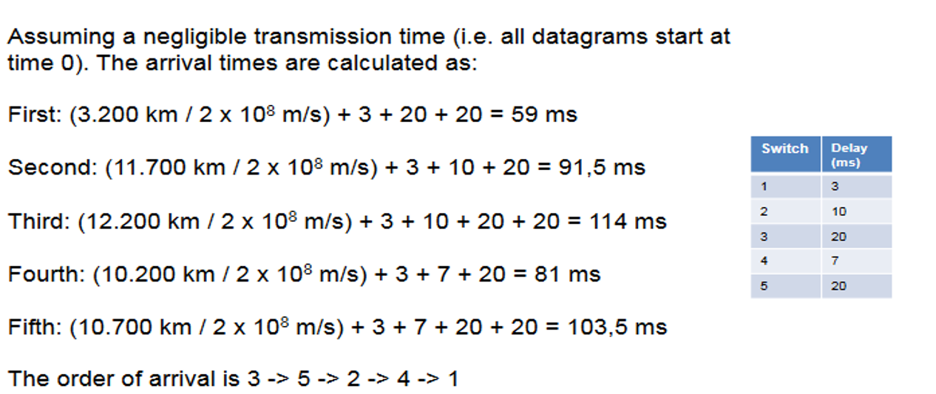

Slide 25
8-3 VIRTUAL-CIRCUIT NETWORKS
A virtual-circuit network is a cross between a circuit- switched network and a datagram network. It has some characteristics of both.
Topics discussed in this section:
Addressing Three Phases Efficiency Delay
Circuit-Switched Technology in WANs

Slide 26
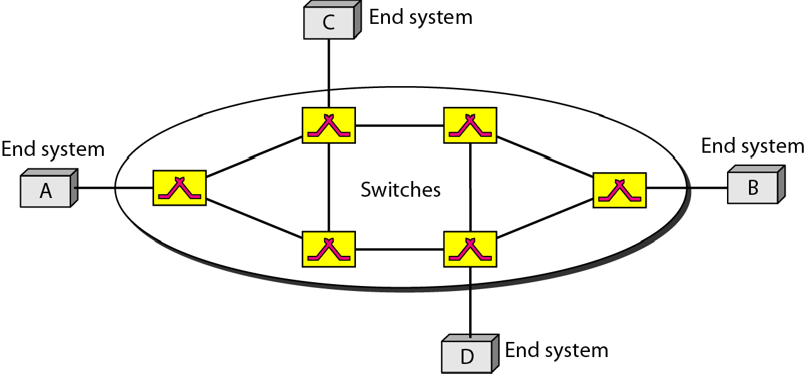
Figure 8.10 Virtual-circuit network

Slide 27
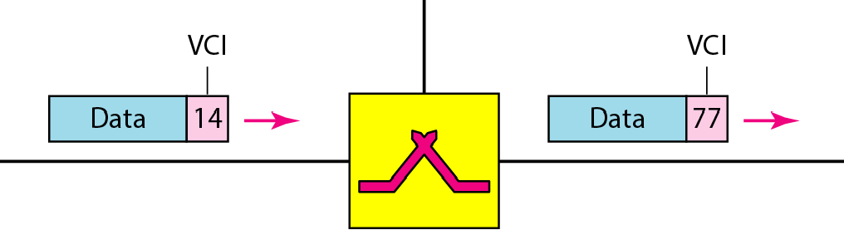
Figure 8.11 Virtual-circuit identifier

Slide 28
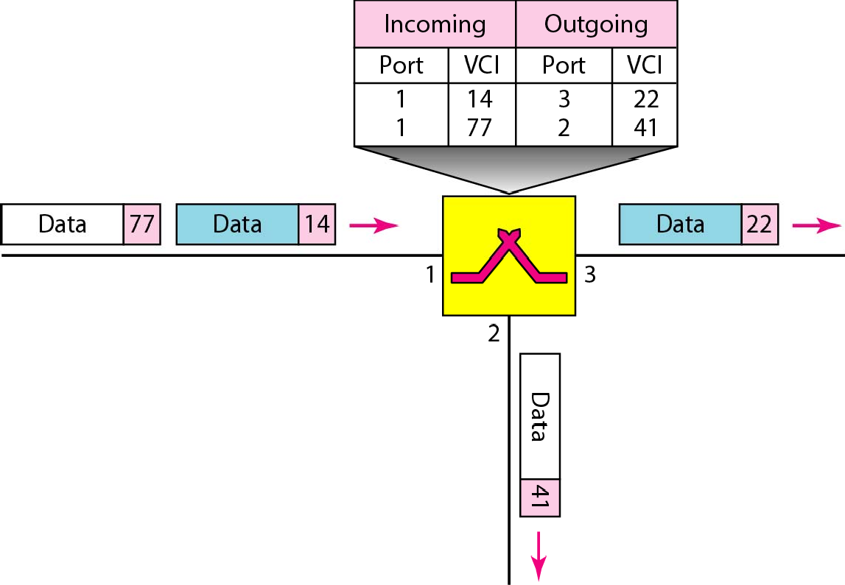
Figure 8.12 Switch and tables in a virtual-circuit network

Slide 29
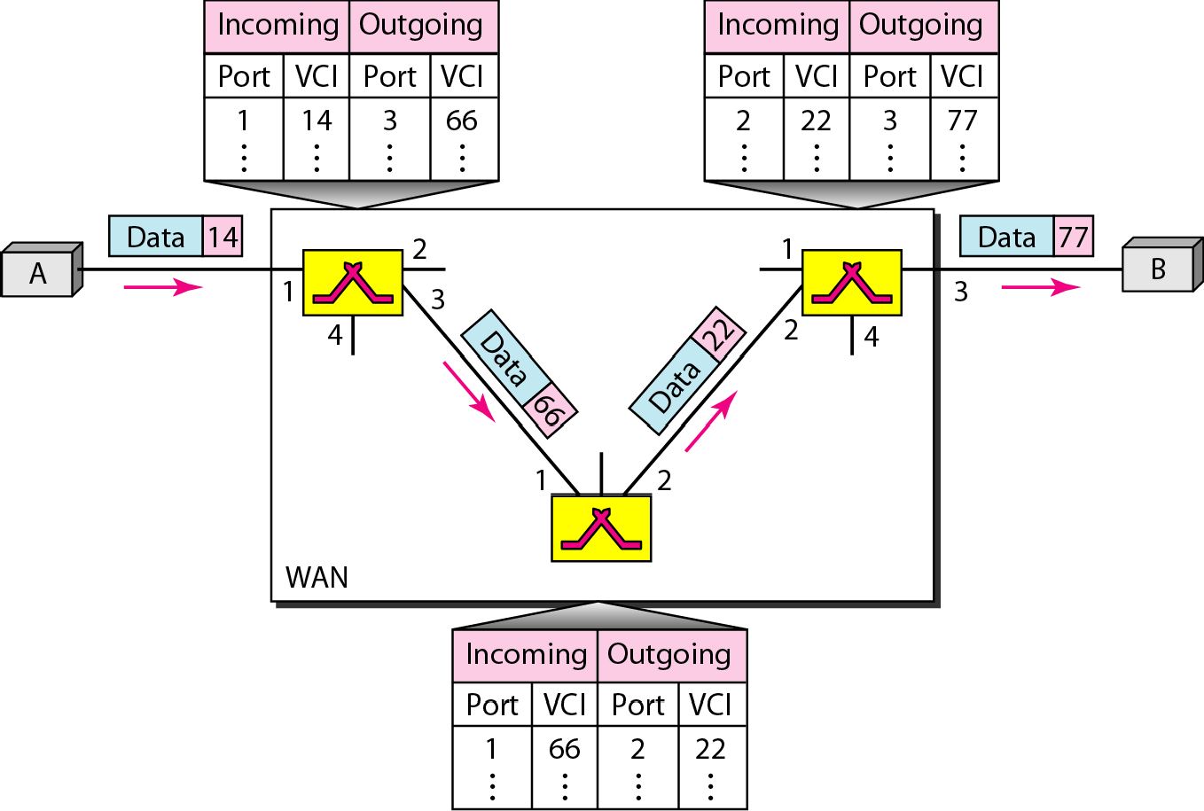
Figure 8.13 Source-to-destination data transfer in a virtual-circuit network

Slide 30
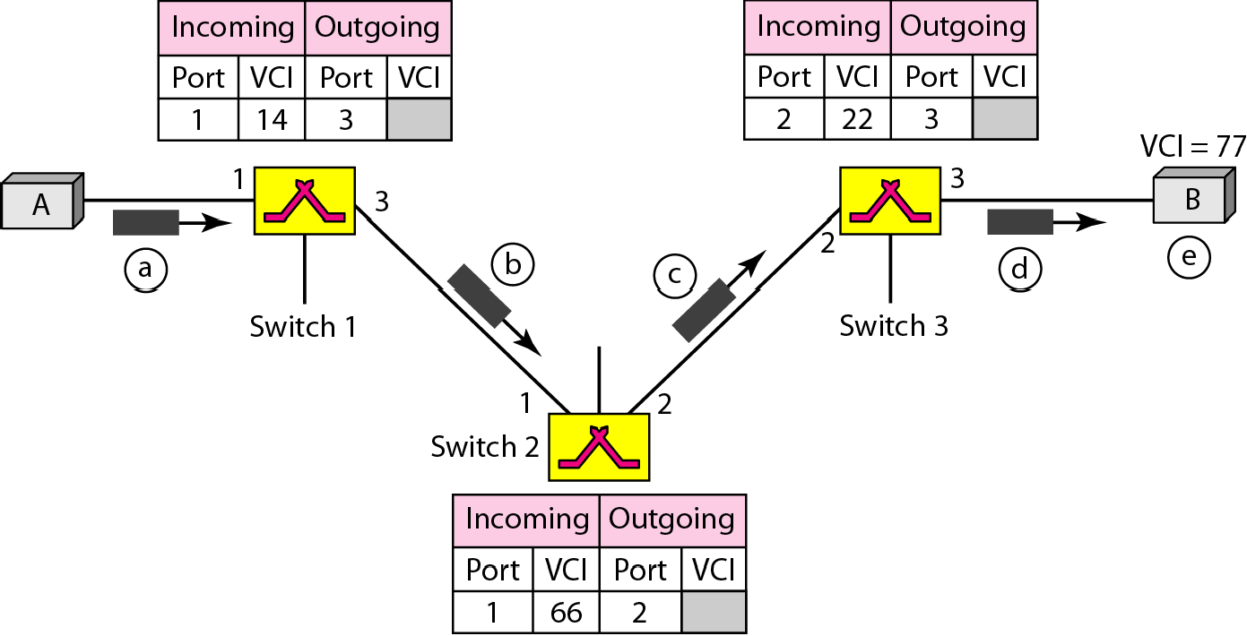
Figure 8.14 Setup request in a virtual-circuit network

Slide 31
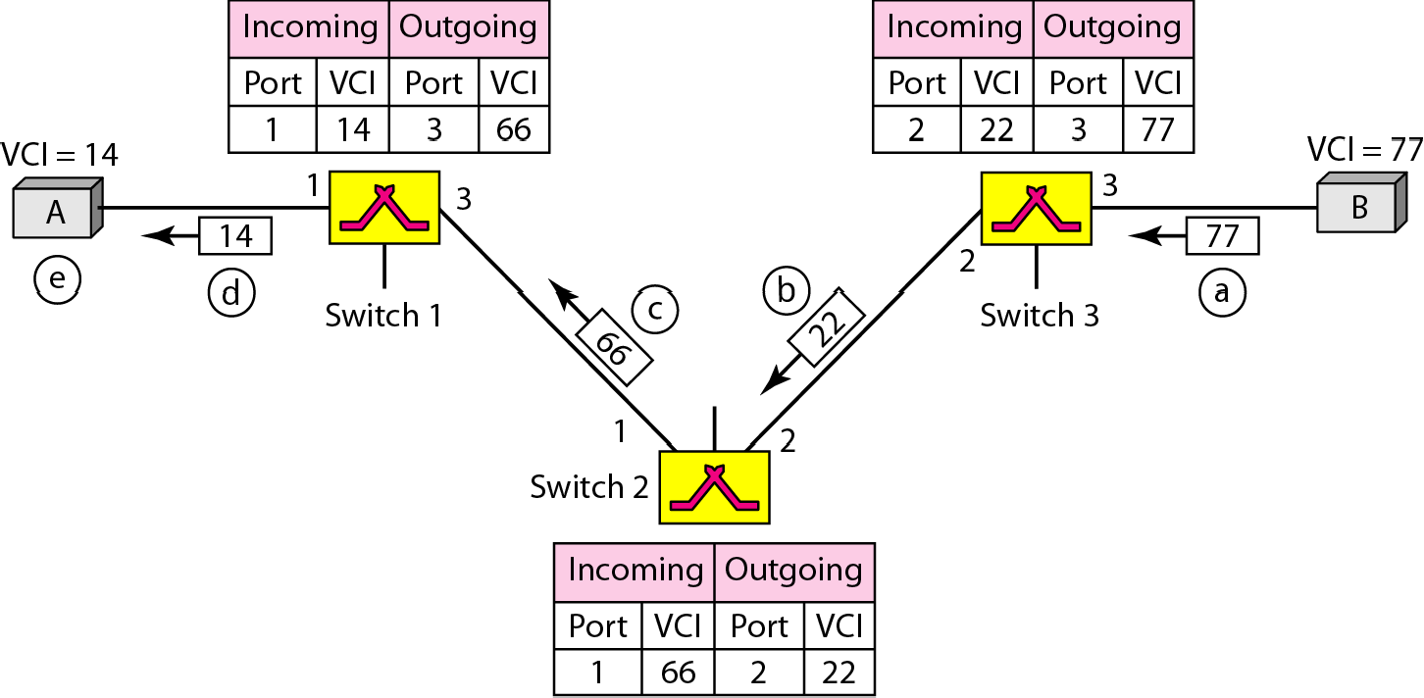
Figure 8.15 Setup acknowledgment in a virtual-circuit network

Slide 32
Note
In virtual-circuit switching, all packets belonging to the same source and destination travel the same path; but the packets may arrive at the
destination with different delays
if resource allocation is on demand.

Slide 33
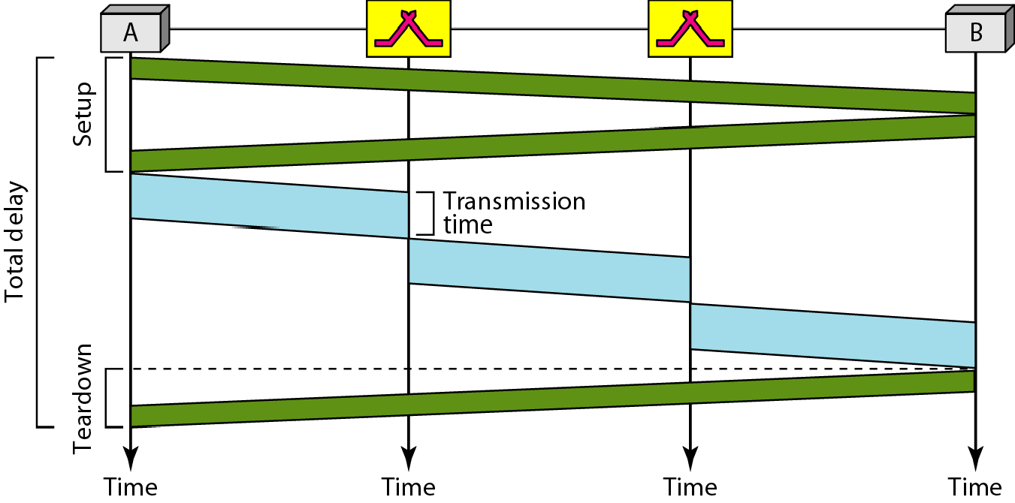
Figure 8.16 Delay in a virtual-circuit network

Slide 34

Note
Switching at the data link layer in a switched WAN is normally implemented by using
virtual-circuit techniques.

Slide 35
8-4 STRUCTURE OF A SWITCH
We use switches in circuit-switched
and packet-
switched networks. In this section, we discuss the structures of the switches used in each type of network.
Topics discussed in this section: Structure of Circuit Switches Structure of Packet Switches

Slide 36
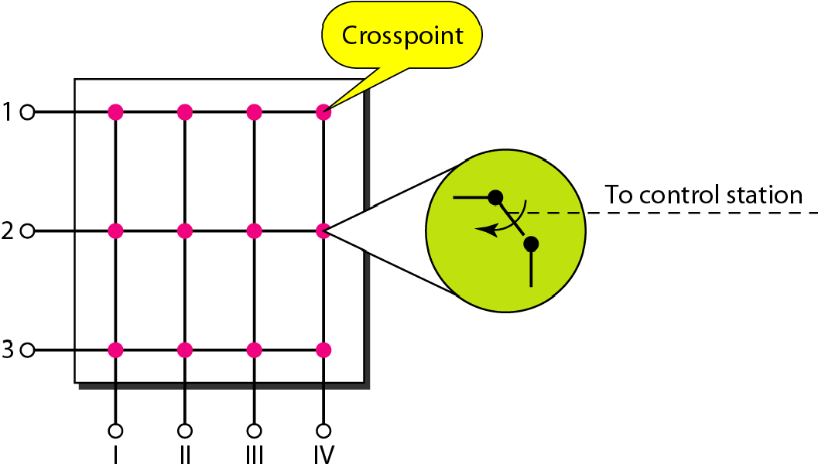
Figure 8.17 Crossbar switch with three inputs and four outputs

Slide 37
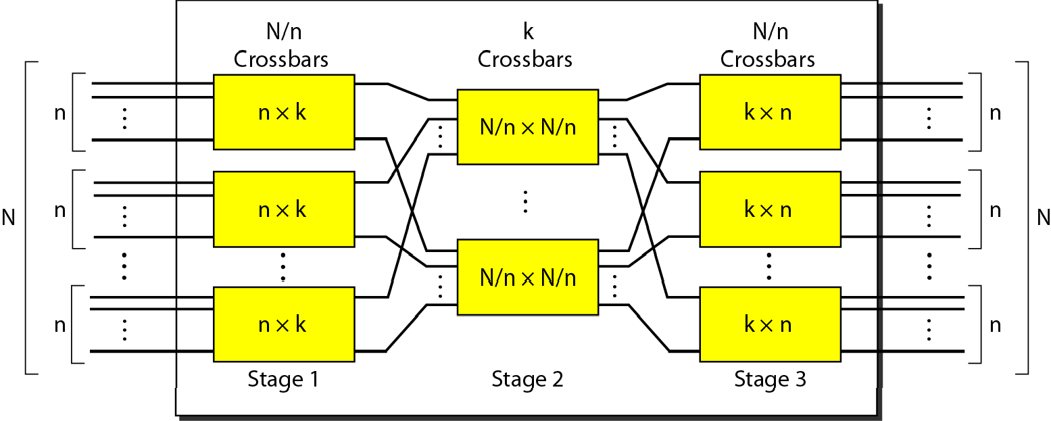
Figure 8.18 Multistage switch

Slide 38
Note
In a three-stage switch, the total number of crosspoints is
2kN + k(N/n)²
which is much smaller than the number of crosspoints in a single-stage switch (N²).

Slide 39
Example 8.3
Design a three-stage, 200 × 200 switch (N = 200) with k = 4 and n = 20.
Solution
In the first stage we have N/n or 10 crossbars, each of size 20 × 4. In the second stage, we have 4 crossbars, each of size 10 × 10. In the third stage, we have 10 crossbars, each of size 4 × 20. The total number of crosspoints is 2kN + k(N/n)², or 2000 crosspoints. This is 5 percent of the number of crosspoints in a single-stage switch (200 × 200 = 40,000).

Slide 40
Note
According to the Clos criterion:
n = (N/2)^{1/2}
k > 2n – 1
Crosspoints ≥ 4N [(2N)^{1/2} – 1]

Slide 41
Example 8.4
Redesign the previous three-stage, 200 × 200 switch, using the Clos criteria with a minimum number of crosspoints.
Solution
We let n = (200/2)^{1/2}, or n = 10. We calculate k = 2n − 1 =
19. In the first stage, we have 200/10, or 20, crossbars, each with 10 × 19 crosspoints. In the second stage, we have 19 crossbars, each with 10 × 10 crosspoints. In the third stage, we have 20 crossbars each with 19 × 10 crosspoints. The total number of crosspoints is 20(10 × 19) + 19(10 × 10) + 20(19 ×10) = 9500.

Slide 42
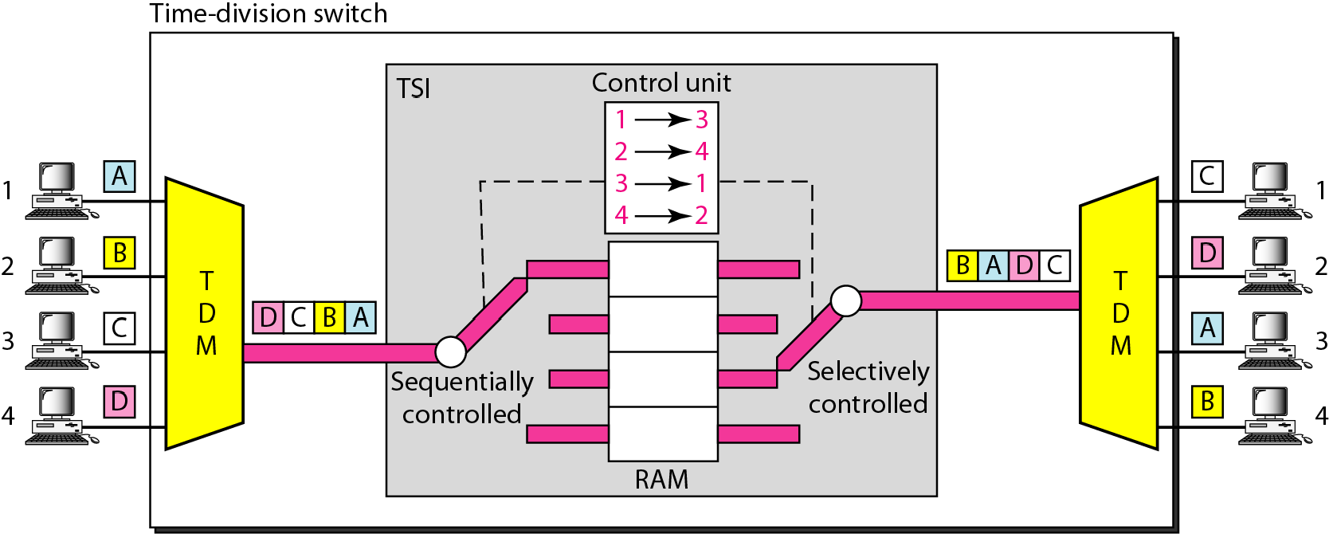
Figure 8.19 Time-slot interchange

Slide 43
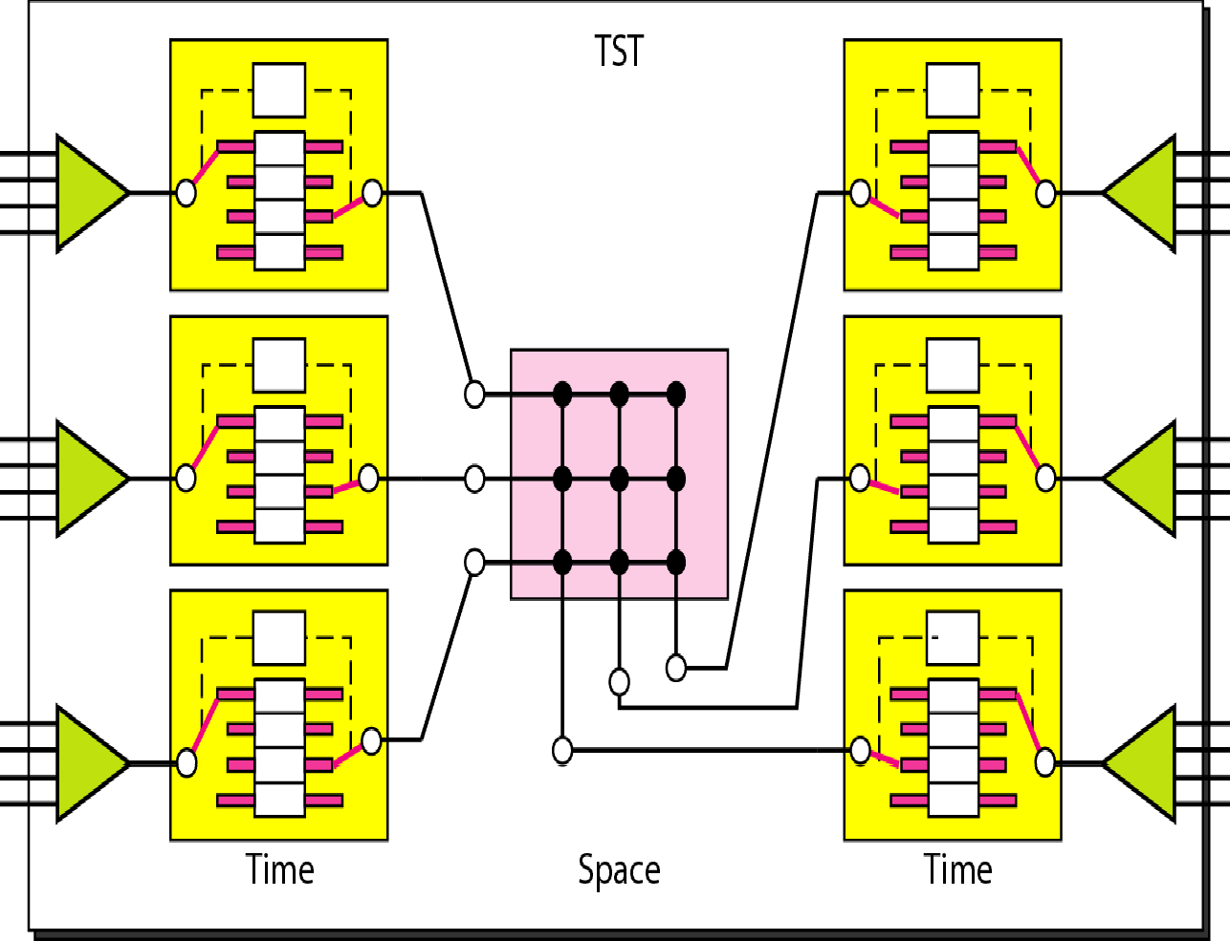
Figure 8.20 Time-space-time switch

Slide 44
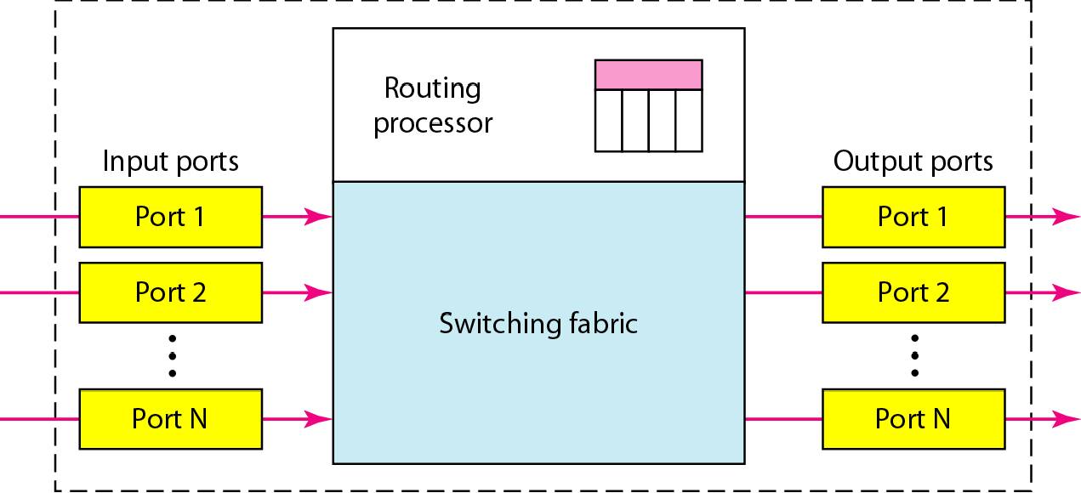
Figure 8.21 Packet switch components

Slide 45
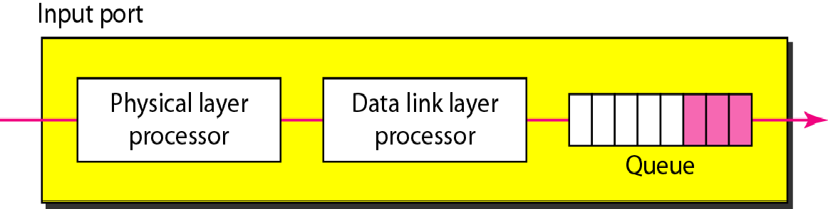
Figure 8.22 Input port

Slide 46
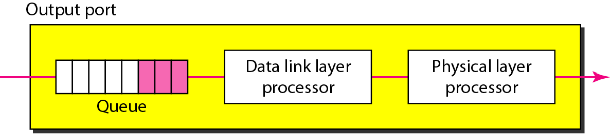
Figure 8.23 Output port

Slide 47
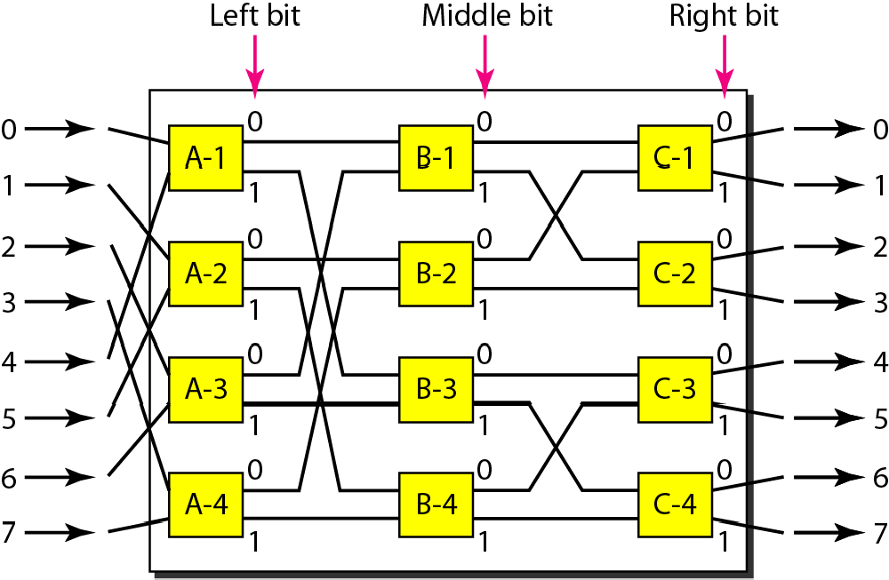
Figure 8.24 A banyan switch

Slide 48
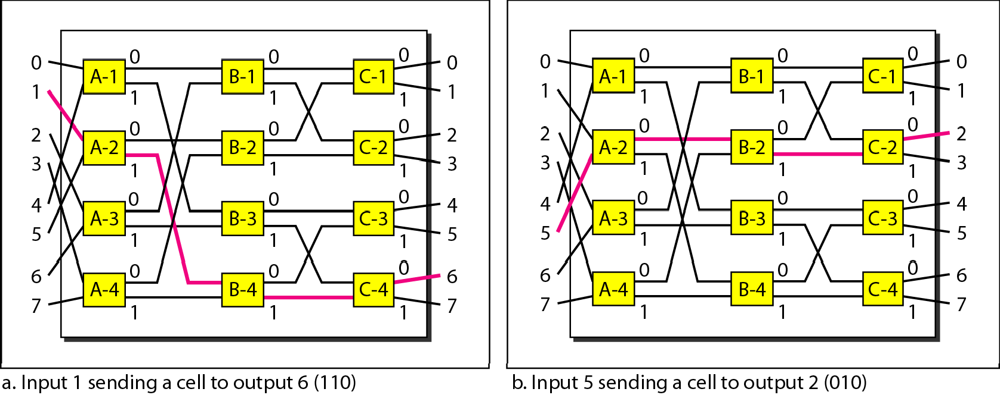
Figure 8.25 Examples of routing in a banyan switch

Slide 49
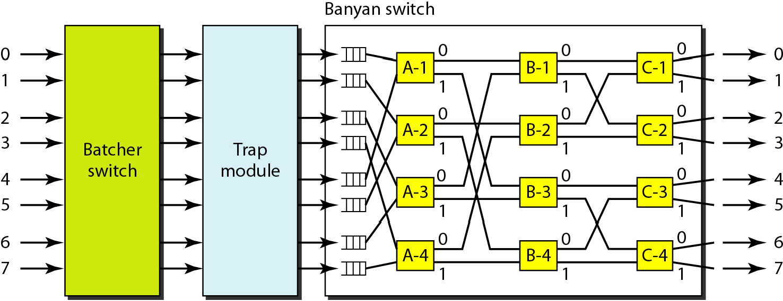
Figure 8.26 Batcher-banyan switch

